Slide 1
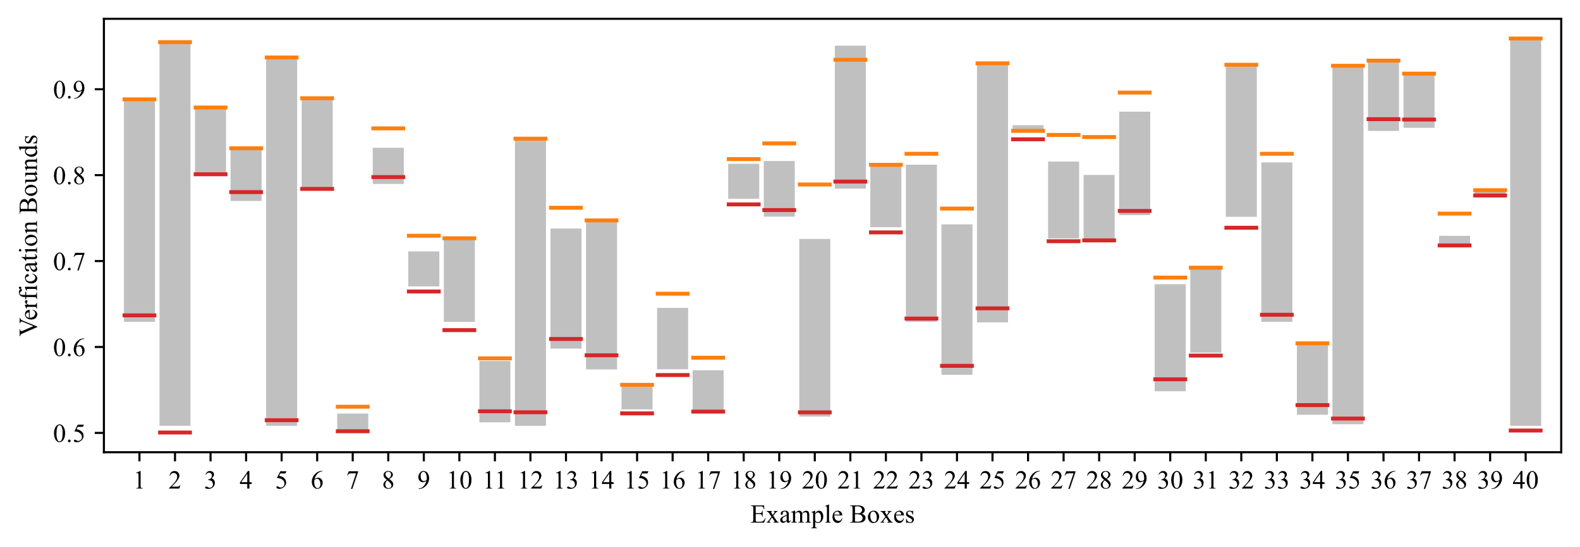
Square attack
PGD attack
Verification
(Ours)
RCP_{N}

